Slide 1

Magic Orchestra
Brain training activities
9team
Elena Buttolo
Mathyas Giudici
Davide Salaorni
Politecnico di Milano
A.A. 2019/20
Advanced User Interfaces
Franca Garzotto

Slide 2




9team
Elena Buttolo
e-mail: elena.buttolo@mail.polimi.it
Phone number: +39 347 576 0184
Mathyas Giudici
e-mail: mathyas.giudici@mail.polimi.it
Phone number: +39 340 286 8540
Davide Salaorni
e-mail: davide.salaorni@mail.polimi.it
Phone number: +39 340 364 5668

Slide 3
Stakeholders
01
02
03
04
People
with and without NDD
(Primary Users)
Caregivers like
therapists or teachers
(Secodary Users)
Family of people with
NDD which participate
to the activities
i3Lab people
Researchers
And specialists

Slide 4
Context
Multi-sensory interactive smart physical indoor space in schools and therapeutic centres

Slide 5
Goals for the primary users
Goals for the secondary users
Create multi-sensory
and game-style activities for brain training
Support the customization of the activities by therapists and teachers
Create predictable, controllable and safe activities to have fun
and chances to play, explore and be creative
Create brain training activities that can enrich the analysis and work of
researchers with different scenarios and situations

Slide 6
Constraints
01
02
03
04
Inability to have all the
literature about brain
training exercises
specifications
Limited precision of the technology used to detect the user’s gestures and movements
Game content must
be scalable in order
to fit different sizes
of smart rooms
Each training task should take approximately at most 10 minutes to complete
Notes:
Inability to have all the literature about brain training exercises specifications, because of the price and the fact that they are reserved only to few universities or research centres;
Limited precision of the technology used to detect the user’s gestures and movements

Slide 7
What is
Magic Orchestra
?

Slide 8
Activities
InstruMaps
Quanti numeri!
Sinfonia di luci
Visual memory
Upper-body interaction
Short term memory
Interaction with RFID reader
Visual spatial memory Walk-around interaction

Slide 9
No-context
Context
Index pattern
Index pattern
or Guided Tour pattern

Slide 10
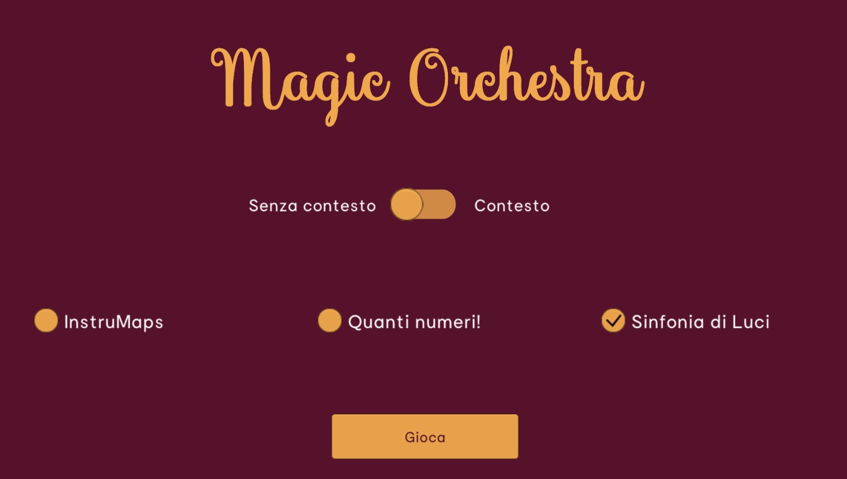

Slide 11
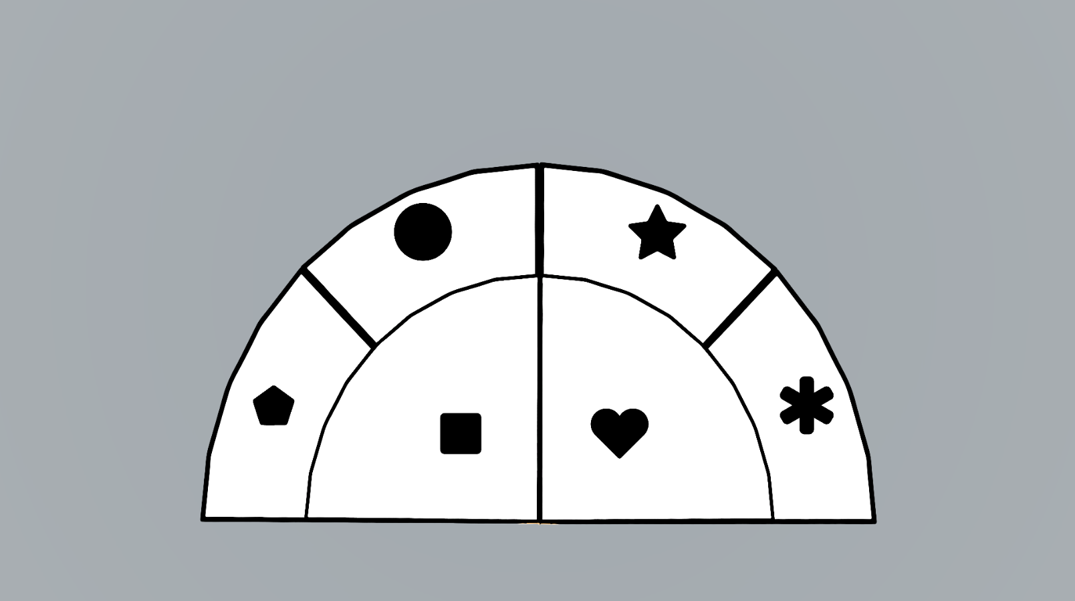
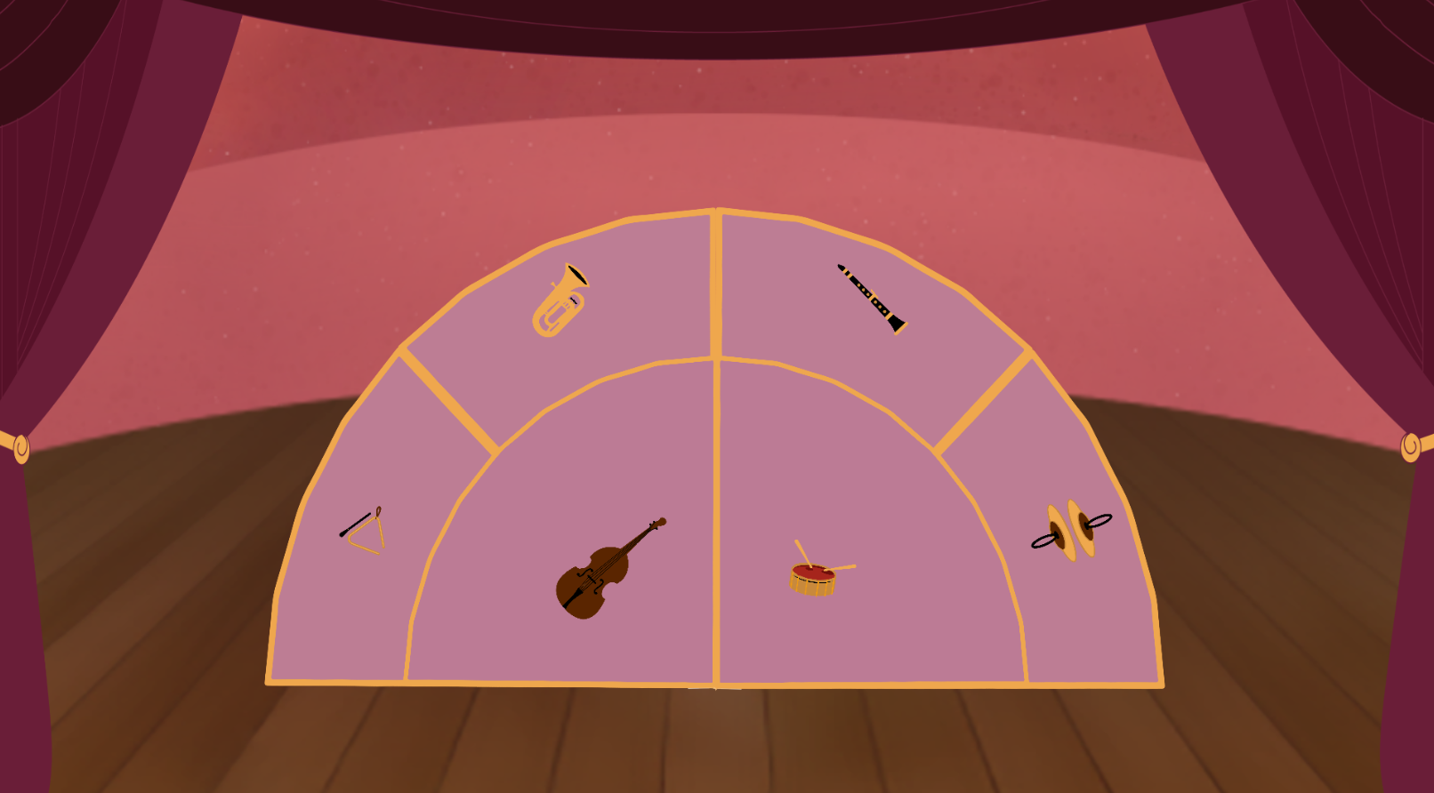
InstruMaps
No-context
Context

Slide 12
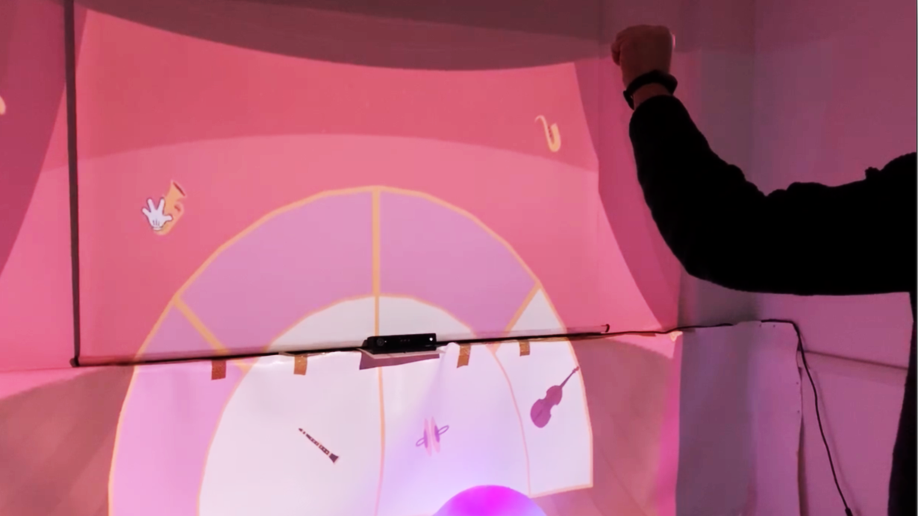

Slide 13

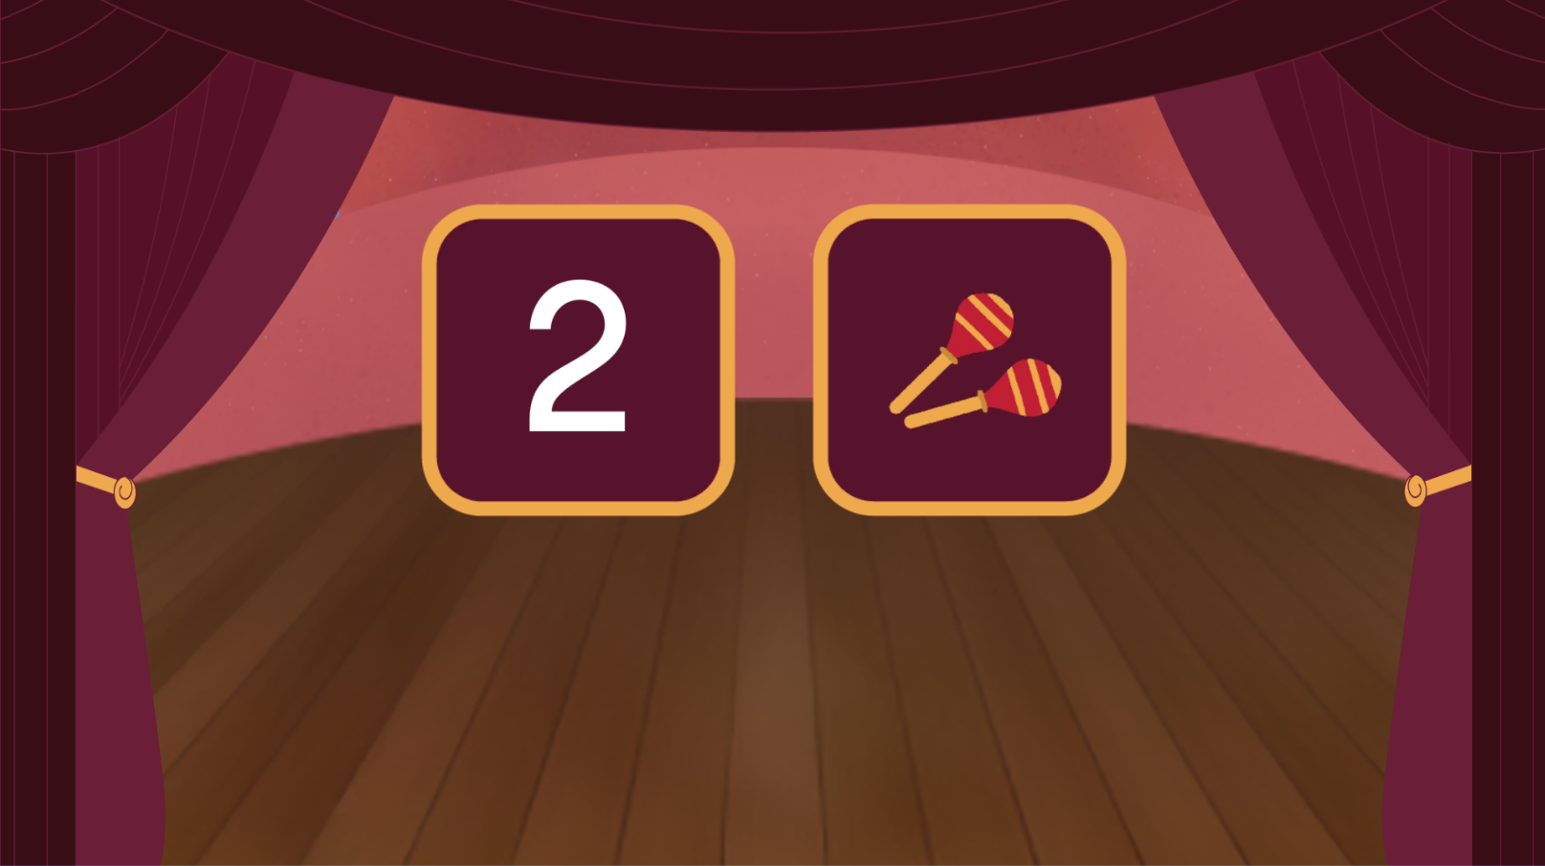
Quanti numeri!
No-context
Context

Slide 14
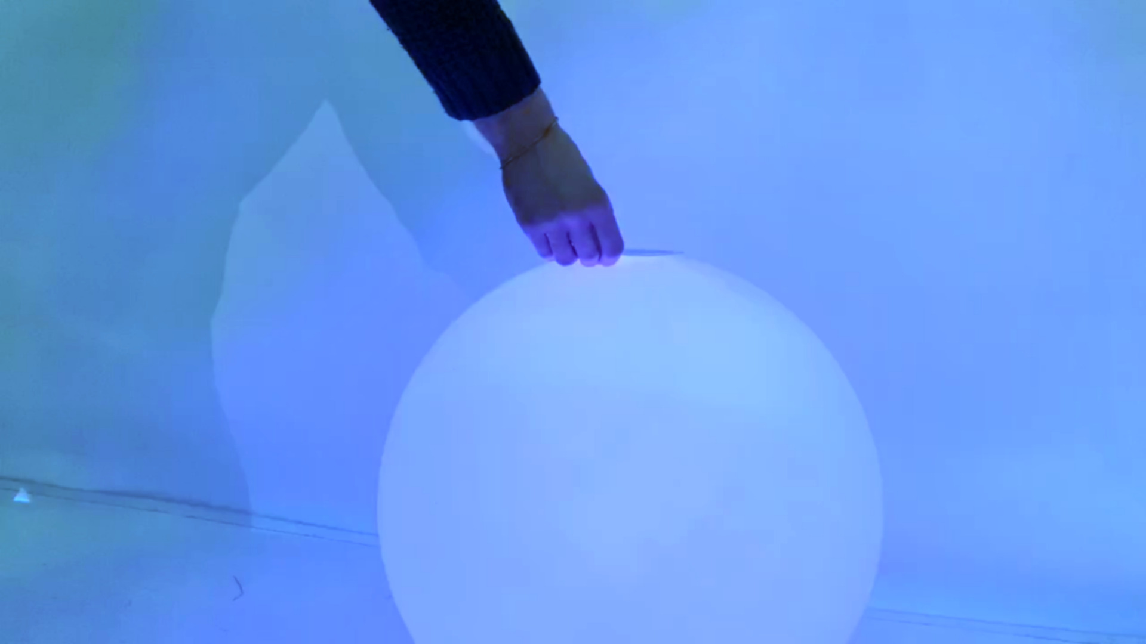

Slide 15
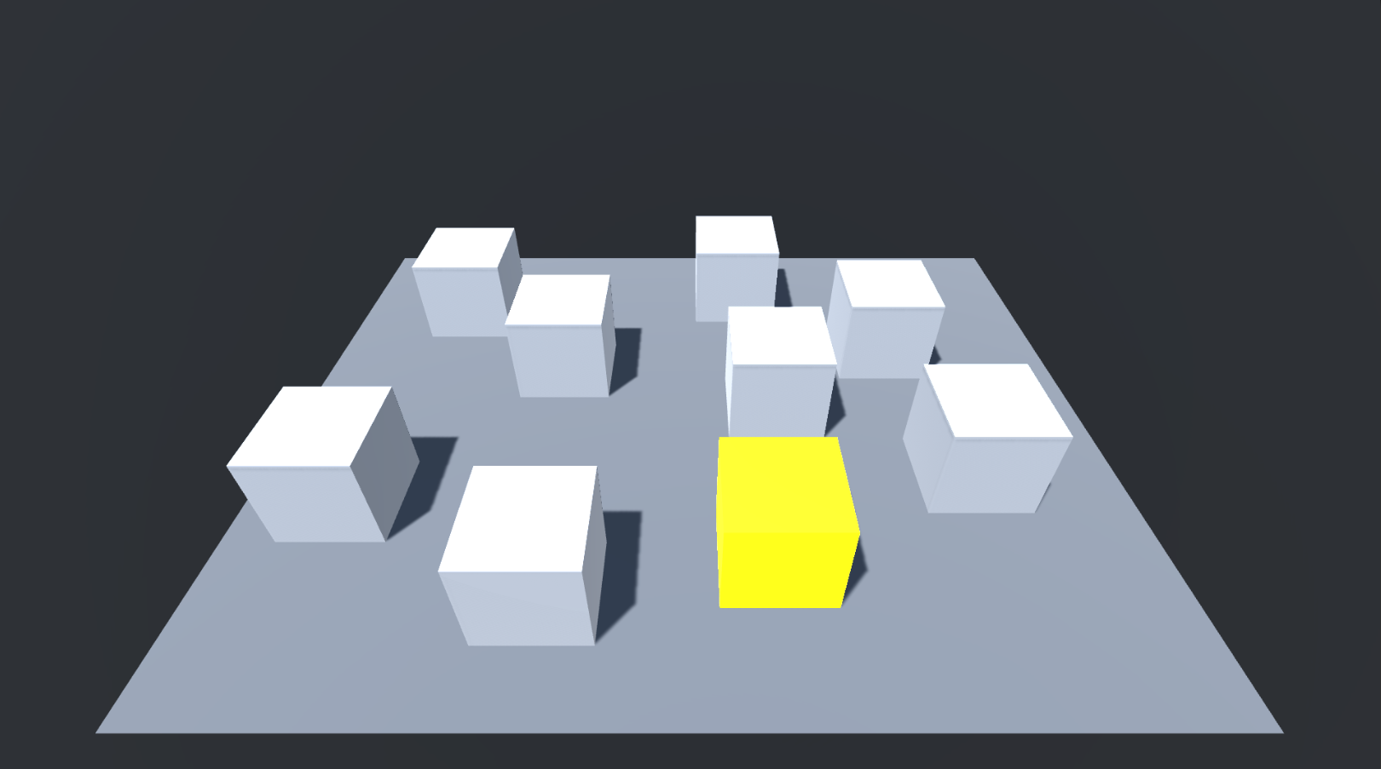
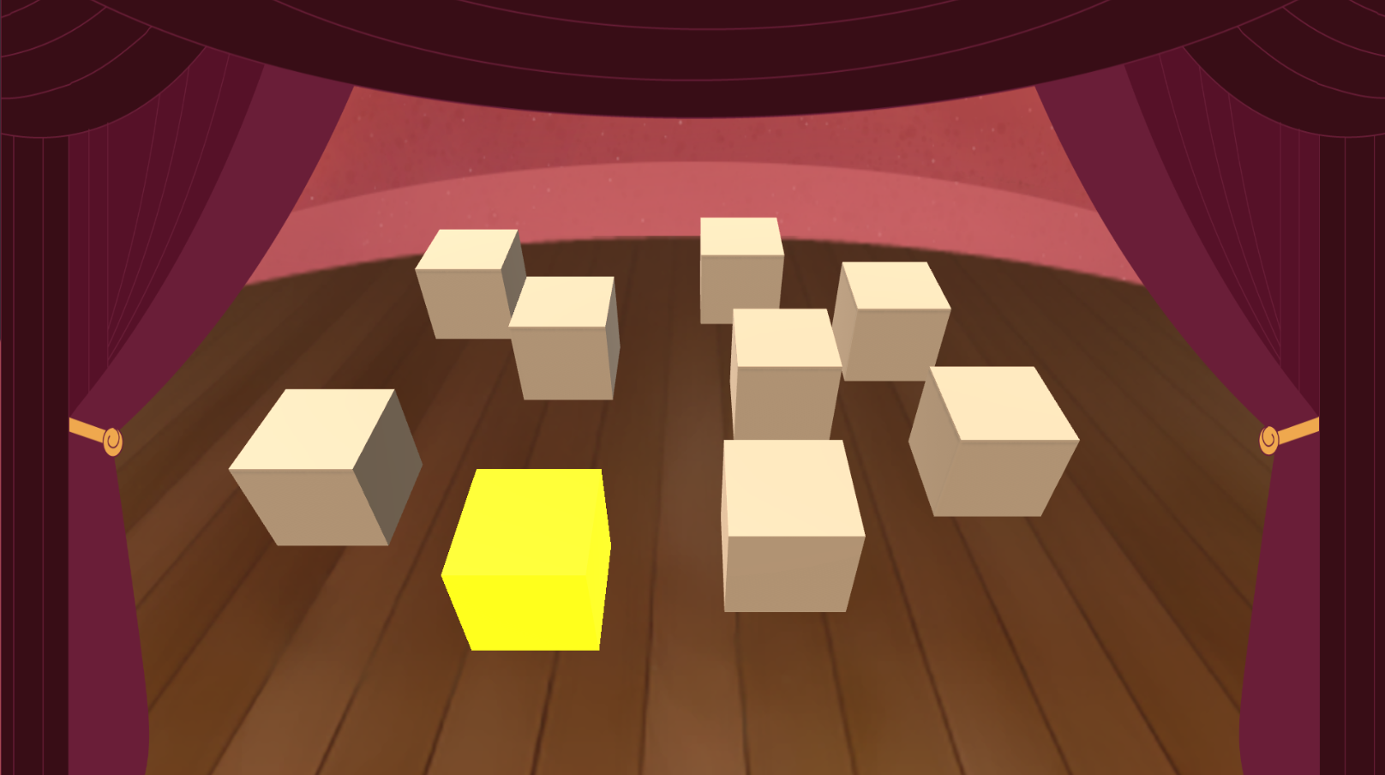
Sinfonia di luci
No-context
Context

Slide 16
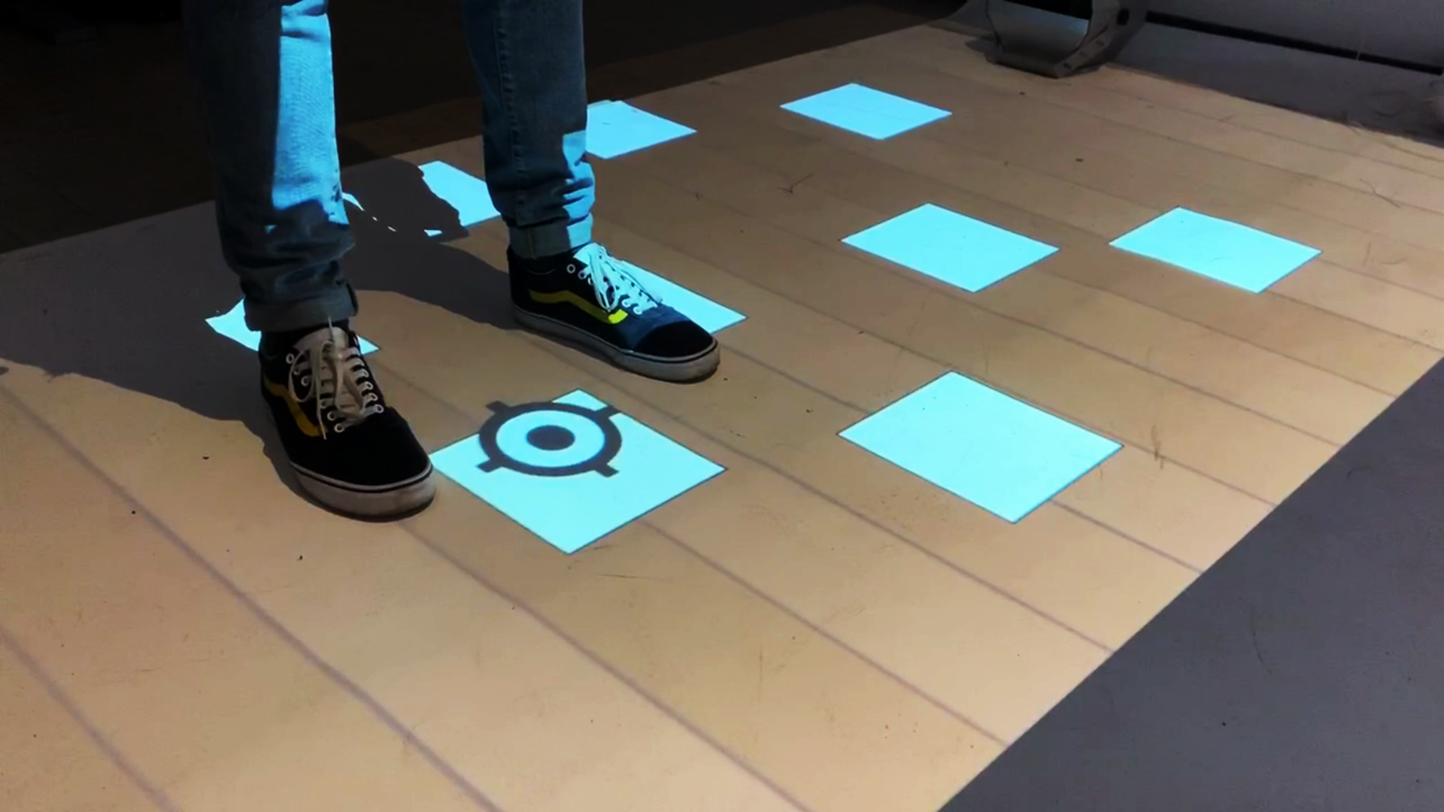

Slide 17
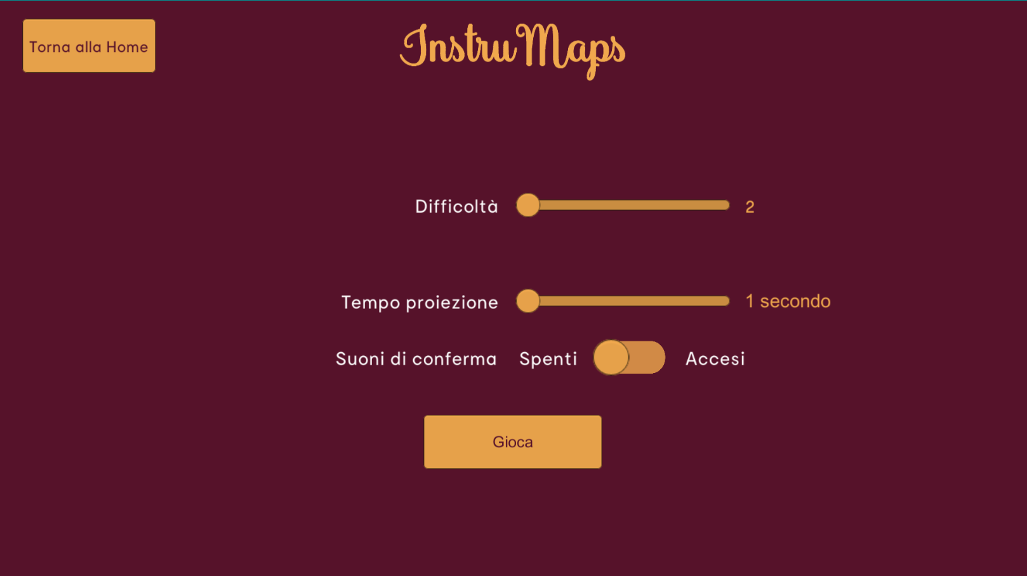

Slide 18
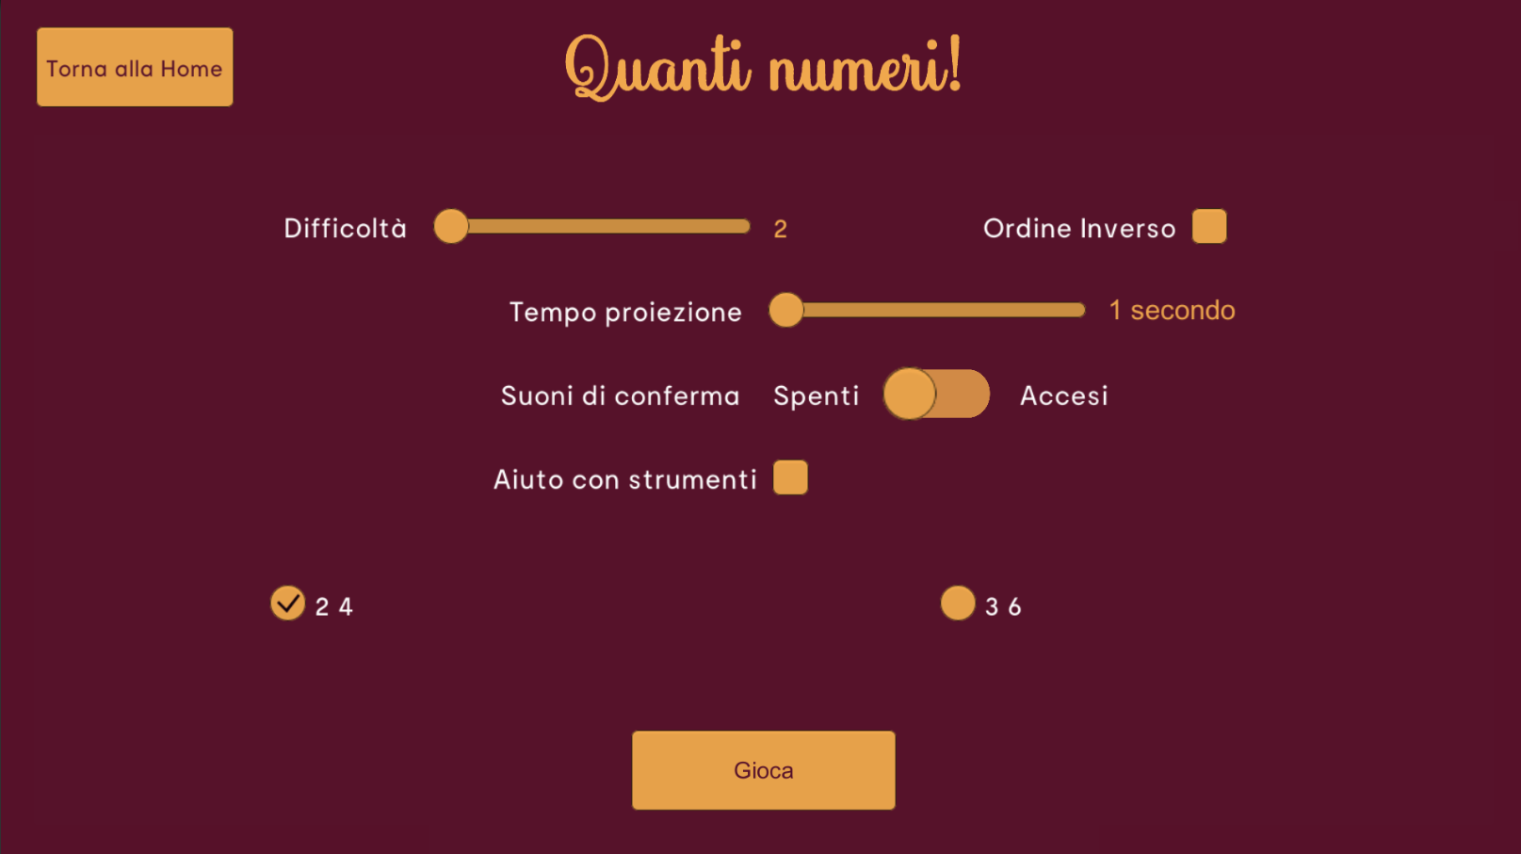

Slide 19
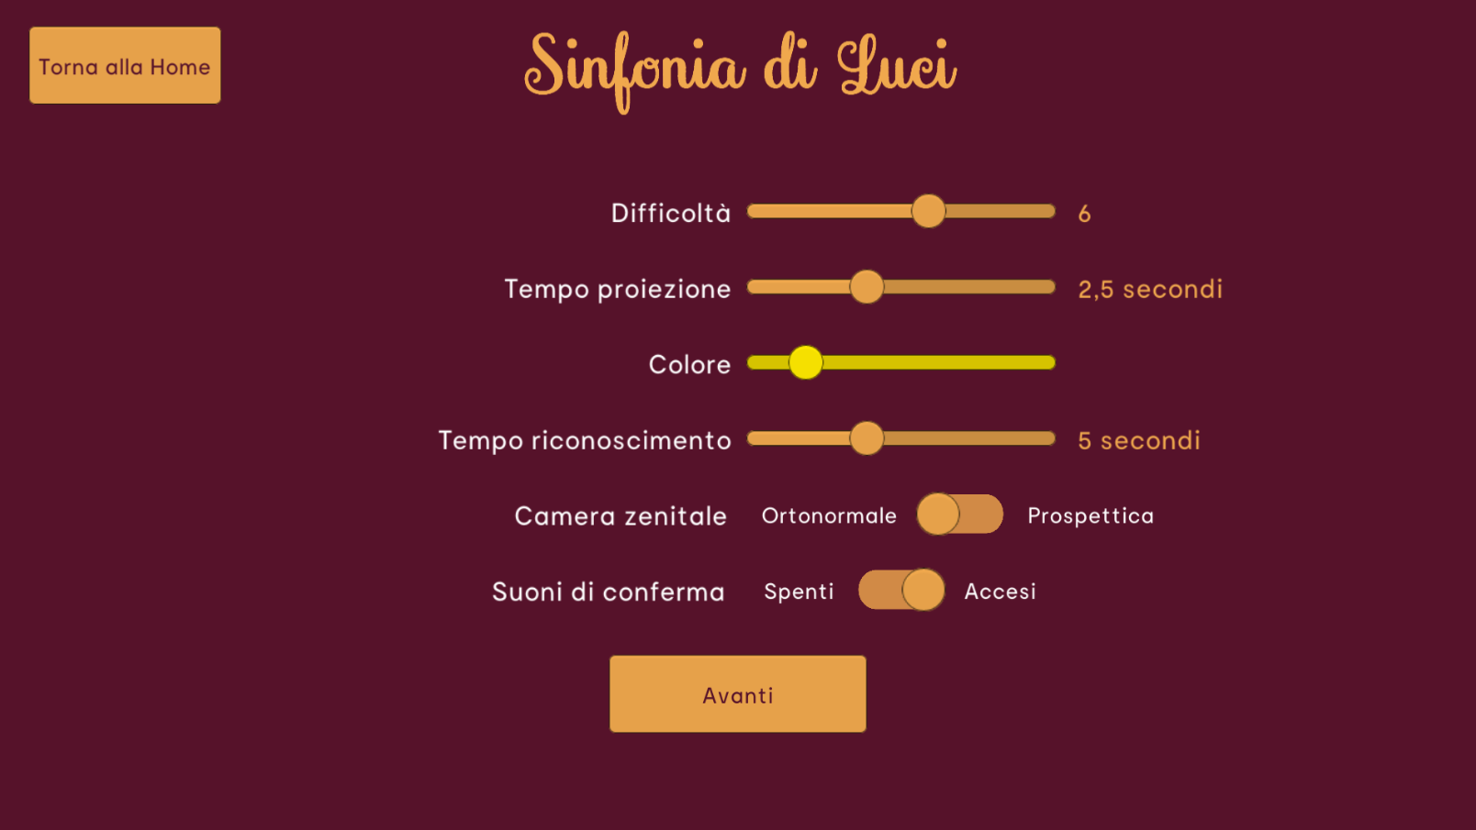

Slide 20
Value Proposition
Engagement
Grounded Literature
Embodied interactions
Customization

Slide 21
Future Works
Caregiver’s tablet interface
New game mode for InstruMaps
More control flow for each activity

Slide 22
Grazie!

